Slide 1








Office of the Dean of School of Agriculture and Technology
RESEARCH &
CAPACITY BUILDING
Presented By.
Dr. R. K. Bannor
Dean, SOAT

Slide 2
SCHOOL OF AGRICULTURE & TECHNOLOGY
Scopus Publication Analysis – December 2021

Slide 3






Presentation Outline
University of Energy & Natural Resources
Scopus Publication Data Output
School of Agriculture & Technology Scopus
Publication Output
Departmental Scopus Publication Output
Authors contribution
Gender statistics
Scopus

Slide 4



University of Energy & Natural Resources Scopus Output
For December 2021
180
Journals
262
Authors
8
Conference Papers
1
Erratum
Scopus is updated daily so you never miss the latest information.

Slide 5

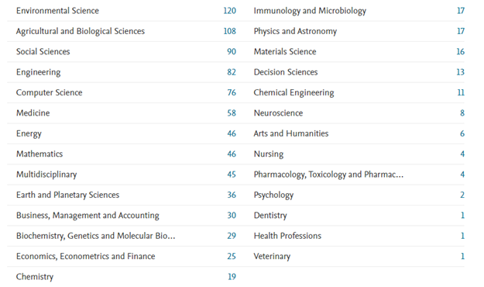
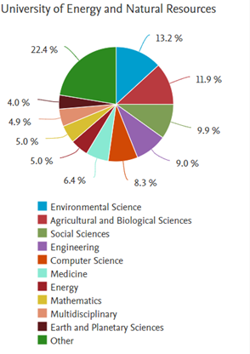
University of Energy & Natural Resources Overall Subject Area Contribution in Scopus

Slide 6
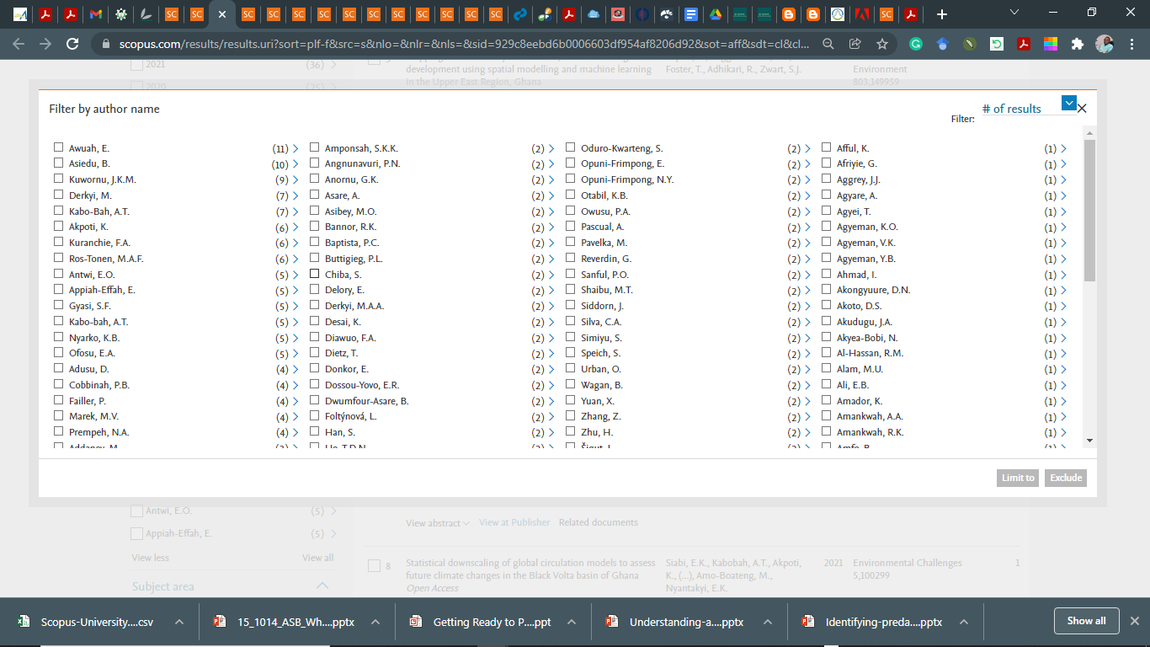
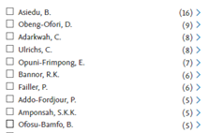
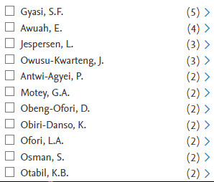
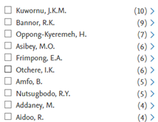
University of Energy & Natural Resources Overall Subject Area Contribution in Scopus
(First 10 Authors)
Environmental Sciences
Agricultural and Biological Sciences
Immunology and Microbiology
Social Sciences

Slide 7
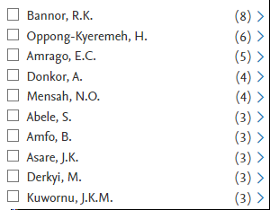
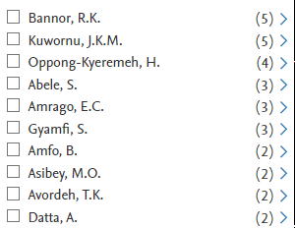
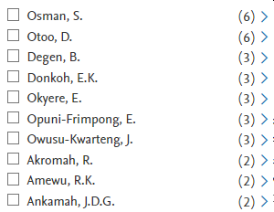
University of Energy & Natural Resources Overall Subject Area Contribution in Scopus
(First 10 Authors)
Economics, Econometrics and Finance
Business, Management and Accounting
Biochemistry, Genetics and Molecular Biology

Slide 8
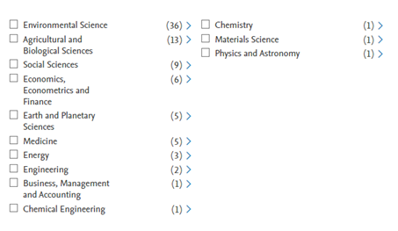
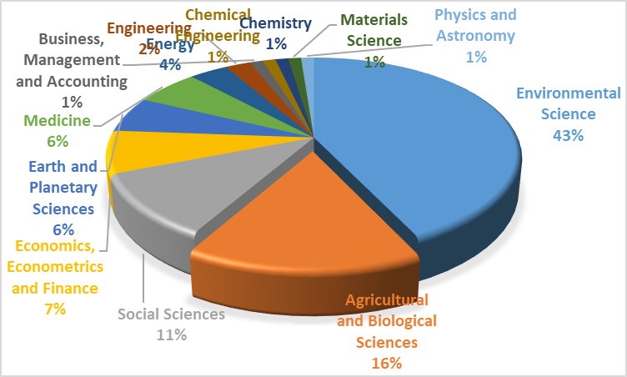
University of Energy & Natural Resources Subject Area Contribution in Scopus – 2021

Slide 9
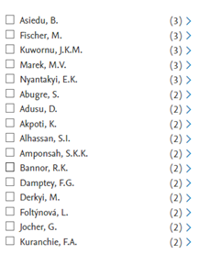
School of Agriculture & Technology Subject Area Contribution in Scopus - 2021
Environmental Sciences
SOAT major contributors in the field of Environmental Sciences

Slide 10
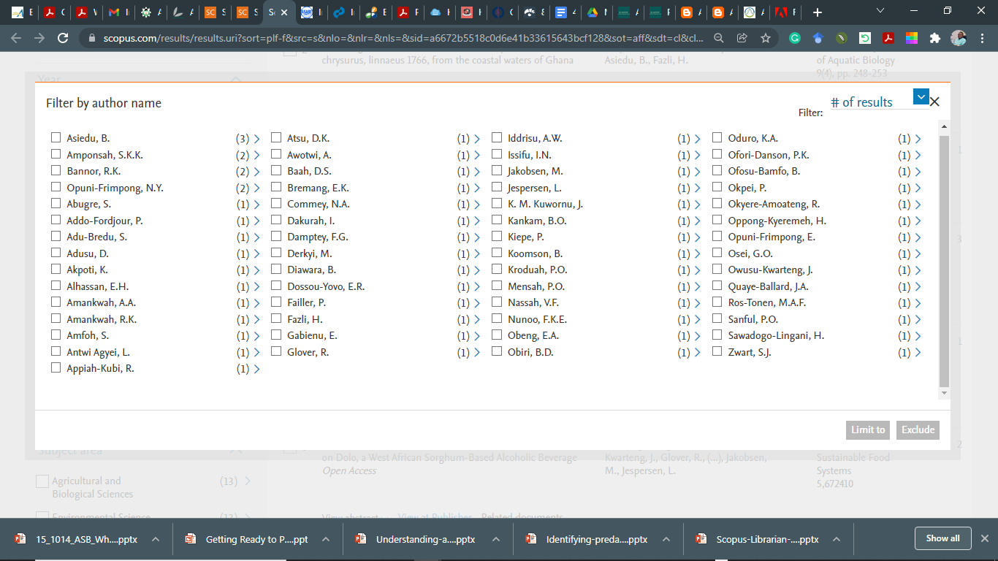
School of Agriculture & Technology Subject Area Contribution in Scopus - 2021
Agricultural and Biological Sciences
SOAT major contributors in the field of Agricultural Sciences

Slide 11
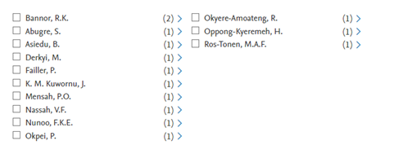
School of Agriculture & Technology Subject Area Contribution in Scopus - 2021
Social Sciences

Slide 12
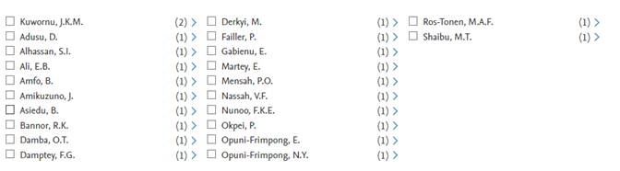
School of Agriculture & Technology Subject Area Contribution in Scopus - 2021
Economics, Econometrics and Finance

Slide 13

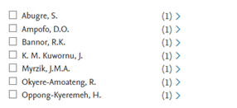
School of Agriculture & Technology Subject Area Contribution in Scopus - 2021
Business, Management and Accounting
Energy

Slide 14
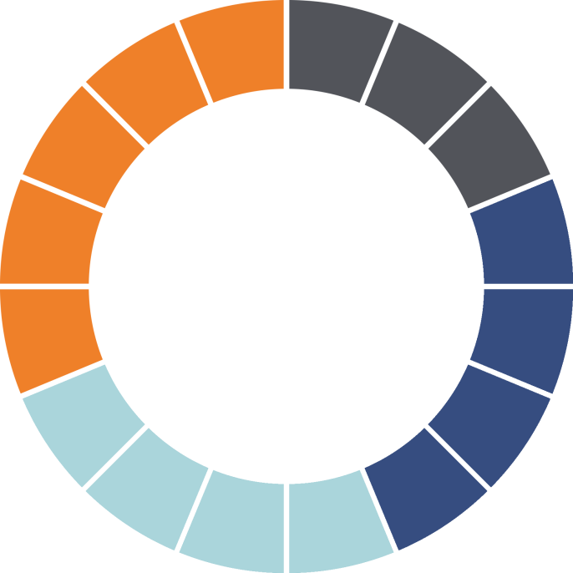

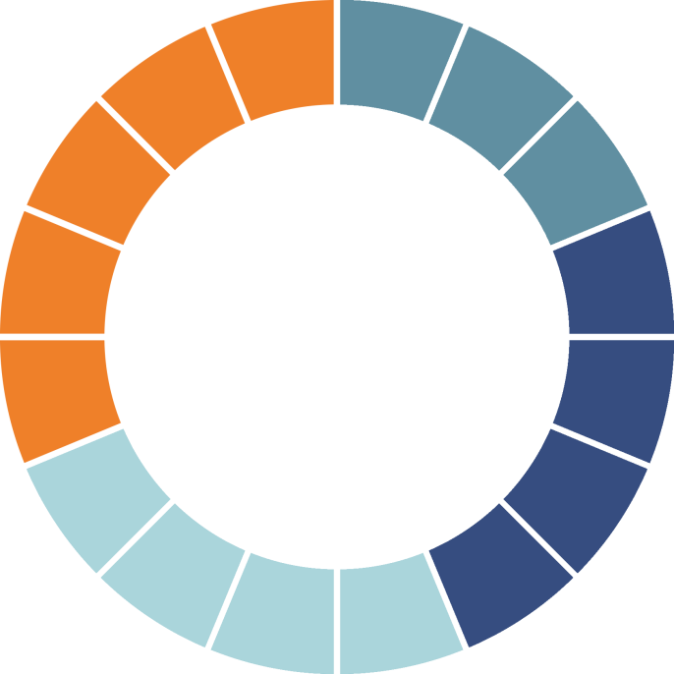







School of Agriculture & Technology Scopus Publications
SOAT
36.67%
SOAT – School of Agriculture & Technology Scopus publications.

Slide 15
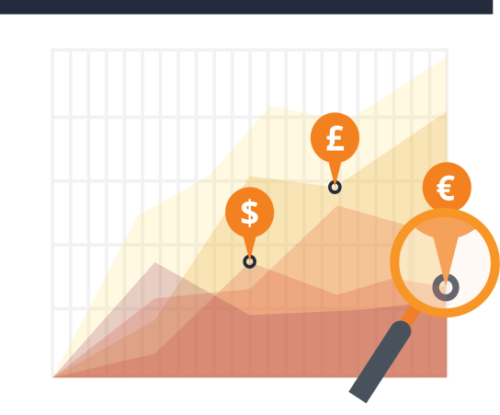





Department of Agricultural Economics, Agribusiness and Extension (DAEAE) Contributions
SOAT
86.36%
UENR
31.67%
SOAT – School of Agriculture & Technology Scopus publications.

Slide 16
Department of Horticulture and Crop Production (DHCP) Scopus Publications
UENR
5%
SOAT
13.64%
SOAT – School of Agriculture & Technology Scopus publications.

Slide 17
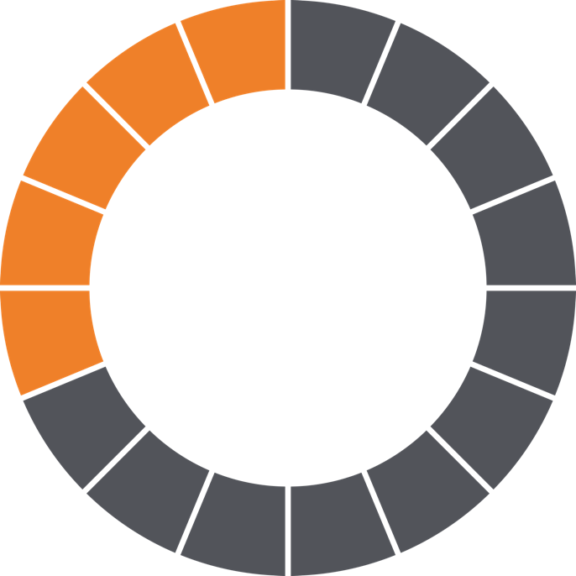
Department of Animal Production & Health (DAPH) Scopus Publications
0%

Slide 18
Gender Statistics of SOAT
Males
Females
61 Publications.
5 Publications.
92.42%
7.58%

Slide 19
Authors Scopus Contributions for December 2021
NOTE – Authors Contributions includes both Staffs and Students of SOAT + authors with their profile outside the UENR Scopus database).

Slide 20



What is the way forward???
Research
Present
Write
Research
is a complex pursuit, so…
…you need
the right tools
at your fingertips.
Evaluate
Publish
Collaborate
……: ………………………………………………………………..

Slide 21

Questions?
If you have any question or suggestions, Please contact richard.bannor@uenr.edu.gh

